Slide 1
Pre - Calculus
Unit 1 Intro to Trig

Slide 2
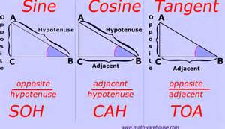
Day 1
Review SOHCAHTOA

Slide 3
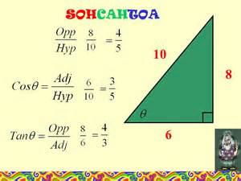
EXAMPLES

Slide 4
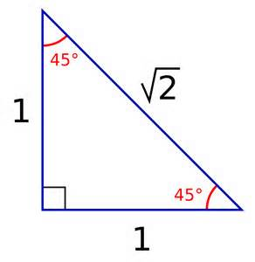
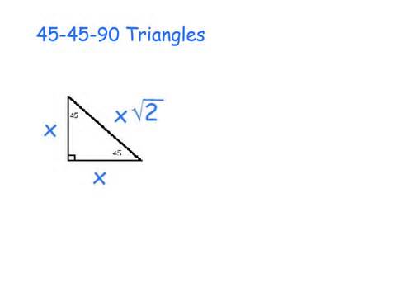
SPECIAL RIGHT TRIANGLES

Slide 5
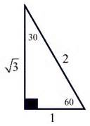
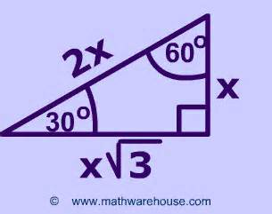
SPECIAL RIGHT TRIANGLES

Slide 6
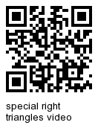
Resources

Slide 7
Warm up August 7
Answer on page 3
1. If a triangle has side lengths 6,8,and 10, is it a right triangle?
2. Find the missing sides of the isosceles right triangle.
***Finish SOHCAHTOA REVIEW
5

Slide 8
Lesson 1 Unit 1
Angles on the Coordinate Plane (Orange Sheet)
Tape/Glue down on p. 5
Examples on p. 6
1. Determine the coterminal angles for each
a. 45º b. 125º c. -100º
2. Determine the reference angle for each of the following
a. 300º b. 210º c. 585º
3. Determine the reference angle for each of the following negative angles
a. -45º b. -120º c. -405º
* Unit 1 Lesson 1 Unit Circle Practice

Slide 9
What is a Radian?
Get your iPad and go to the What is a radian task tab. Follow the questions (use your circle you created yesterday)
Add the pink notes to p. 7
Answer the questions to the practice radians link on p. 8.

