Slide 1
Functions vs Relations

Slide 2
Algebra
UNIT QUESTION: How can we use real-world situations to construct and compare linear and exponential models and solve problems?
Standards: MCC9-12.A.REI.10, 11, F.IF.1-7, 9, F.BF.1-3, F.LE.1-3, 5
Today’s Question:
What is a function, and how is function notation used to evaluate functions?
Standard: MCC9-12.F.IF.1 and 2

Slide 3
Standard: F.IF.1 and F.IF.2
F.IF. 1 Understand that a function from one set (called domain) to another set (called range) assigns to each element of the domain exactly one element of the range. If f is a function and x is an element of its domain, then f(x) denotes the output of f corresponding to the input x. The graph of f is the graph of the equation y=f(x).
F.IF.2 Use function notation, evaluate functions for inputs in their domains, and interpret statements that use function notation in terms of a context.

Slide 4
Relation
Any set of input that has an output

Slide 5
Function
A relation where EACH input has exactly ONE output
Each element from the domain is paired with one and only one element from the range

Slide 6
Domain
x – coordinates
Independent variable
Input

Slide 7
Range
y – coordinates
Dependent variable
Output

Slide 8
How do I know it’s a function?
Look at the input and output table – Each input must have exactly one output.
Look at the Graph – The Vertical Line test: NO vertical line can pass through two or more points on the graph

Slide 9
Function or relation?
Example 1:
{(3, 2), (4, 3), (5, 4), (6, 5)}
function

Slide 10
Function or relation?
Example 2:
function

Slide 11
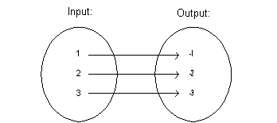
Function or relation?
Example 3:
relation

Slide 12
Function or relation?
Example 4:
( x, y) = (student’s name, shirt color)
function

Slide 13
Function or relation?
Example 5: Red Graph
relation

Slide 14
Function or relation?
Example 6
Jacob
Angela
Nick
Greg
Tayla
Trevor
Honda
Toyota
Ford
function

Slide 15
Function or relation?
Example 7
A person’s cell phone number versus their name.
function

Slide 16
Function Notation

Slide 17
Function form of an equation
A way to name a function
f(x) is a fancy way of writing “y” in an equation.
Pronounced “f of x”

Slide 18
Evaluating Functions

Slide 19
8. Evaluating a function
Tell me what you get when x is -2.
f(x) = 2x – 3 when x = -2
f(-2) = 2(-2) – 3
f(-2) = - 4 – 3
f(-2) = - 7

Slide 20
9. Evaluating a function
Tell me what you get when x is 3.
f(x) = 32(2)^{x} when x = 3
f(3) = 32(2)³
f(3) = 256

Slide 21
10. Evaluating a function
Tell me what you get when x is -3.
f(x) = x² – 2x + 3 find f(-3)
f(-3) = (-3)² – 2(-3) + 3
f(-3) = 9 + 6 + 3
f(-3) = 18

Slide 22
11. Evaluating a function
Tell me what you get when x is 3.
f(x) = 3^{x} + 1 find f(3)
f(3) = 3³ + 1
f(3) = 28

Slide 23
Domain and Range
Only list repeats once
Put in order from least to greatest

Slide 24
12. What are the Domain and Range?
Domain:
Range:
{1, 2, 3, 4, 5, 6}
{1, 3, 6, 10, 15, 21}

Slide 25
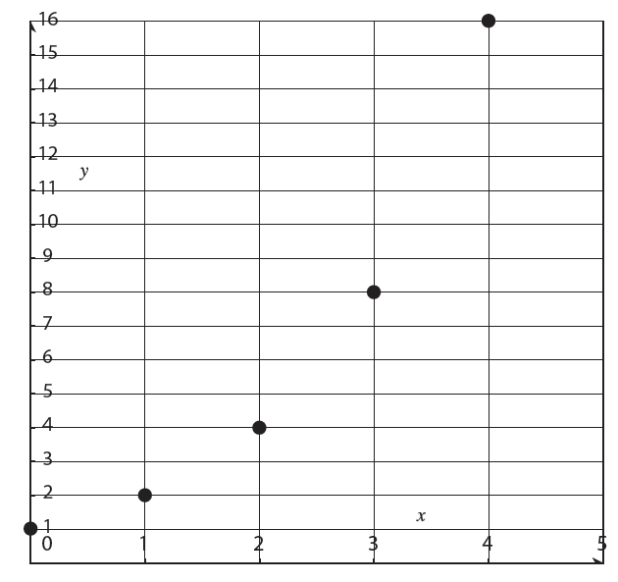
13. What are the Domain and Range?
Domain:
Range:
{0, 1, 2, 3, 4}
{1, 2, 4, 8, 16}

Slide 26
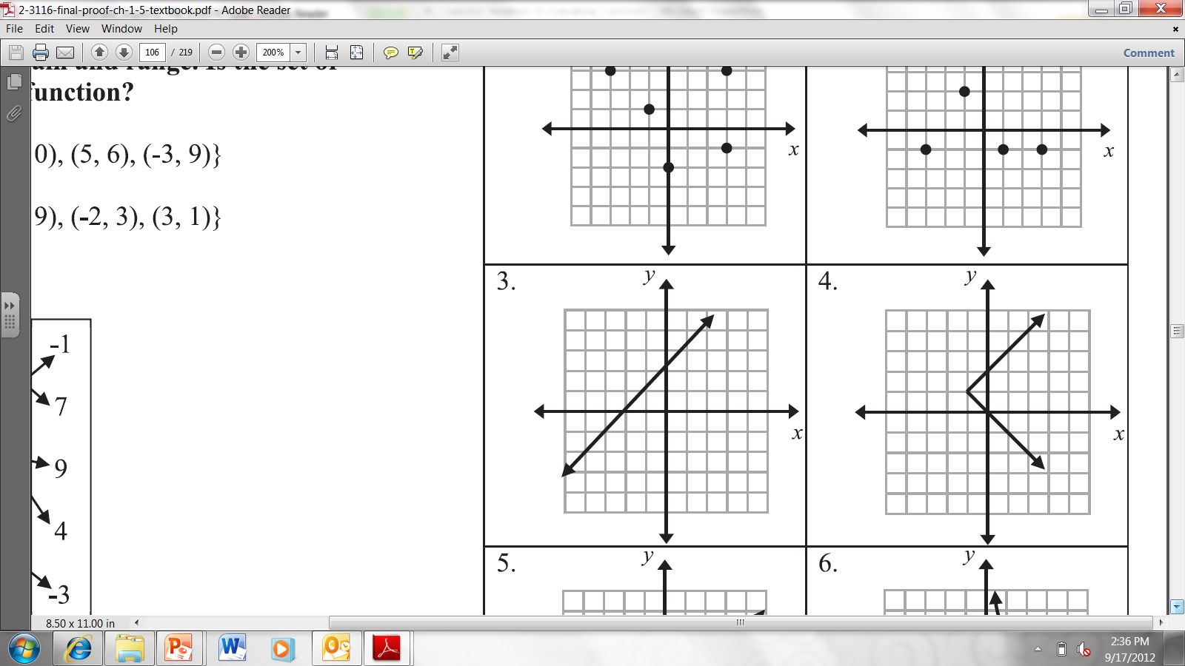
14. What are the Domain and Range?
Domain:
Range:
All Reals
All Reals

Slide 27
15. What are the Domain and Range?
Domain:
Range:
x ≥ -1
All Reals

Slide 28
Homework/Classwork
Function Practice
Worksheet

